Slide 1






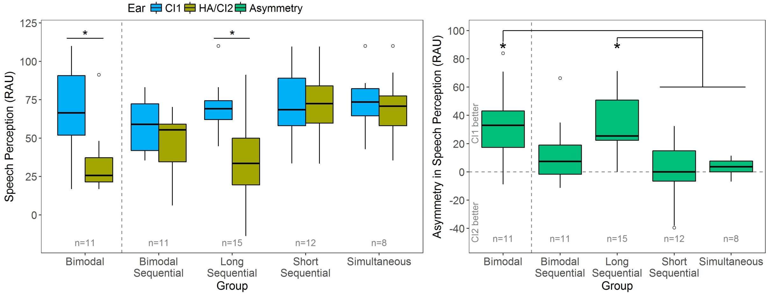
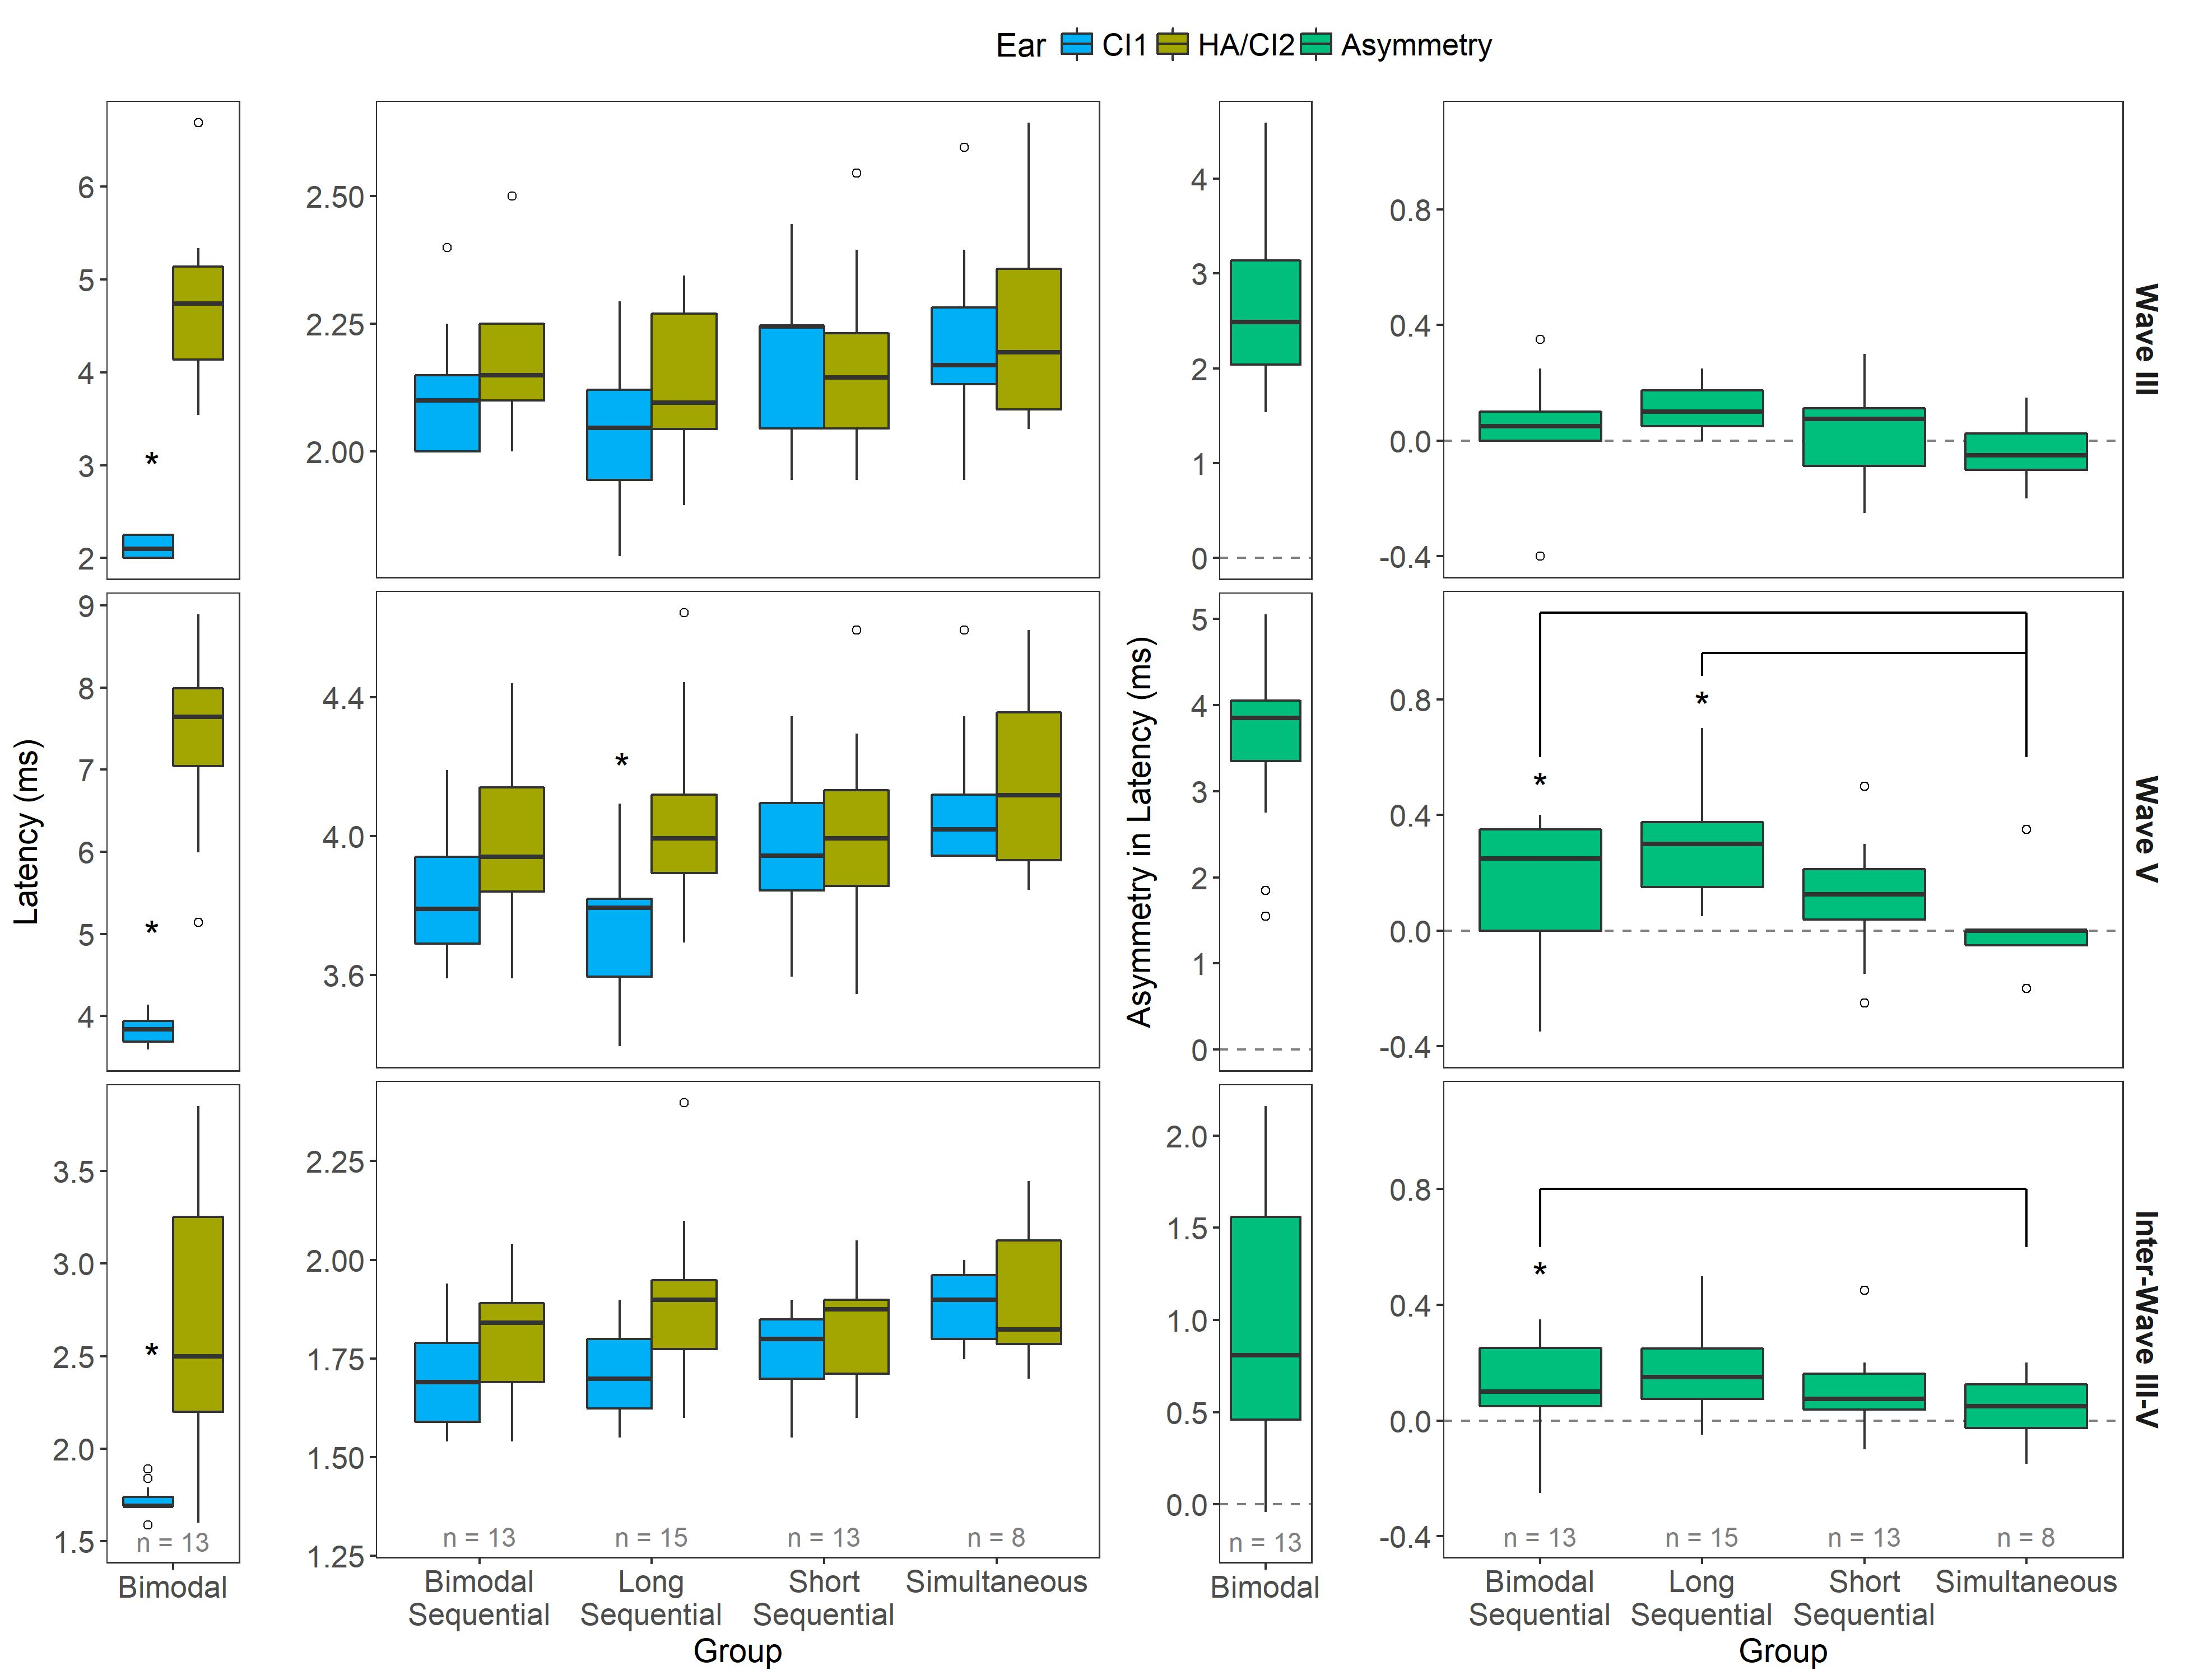
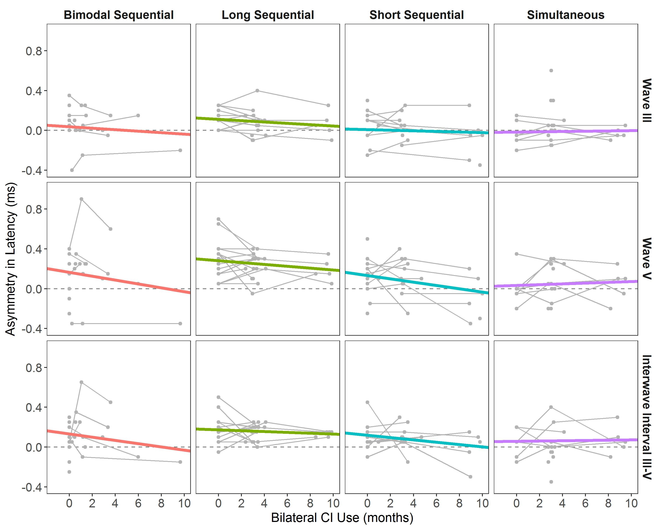

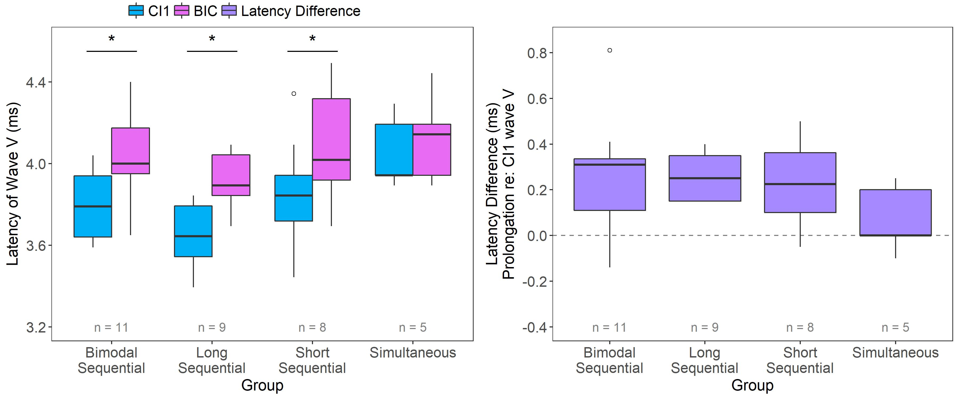
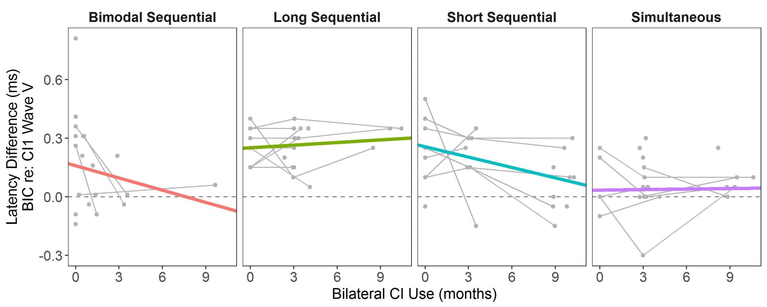
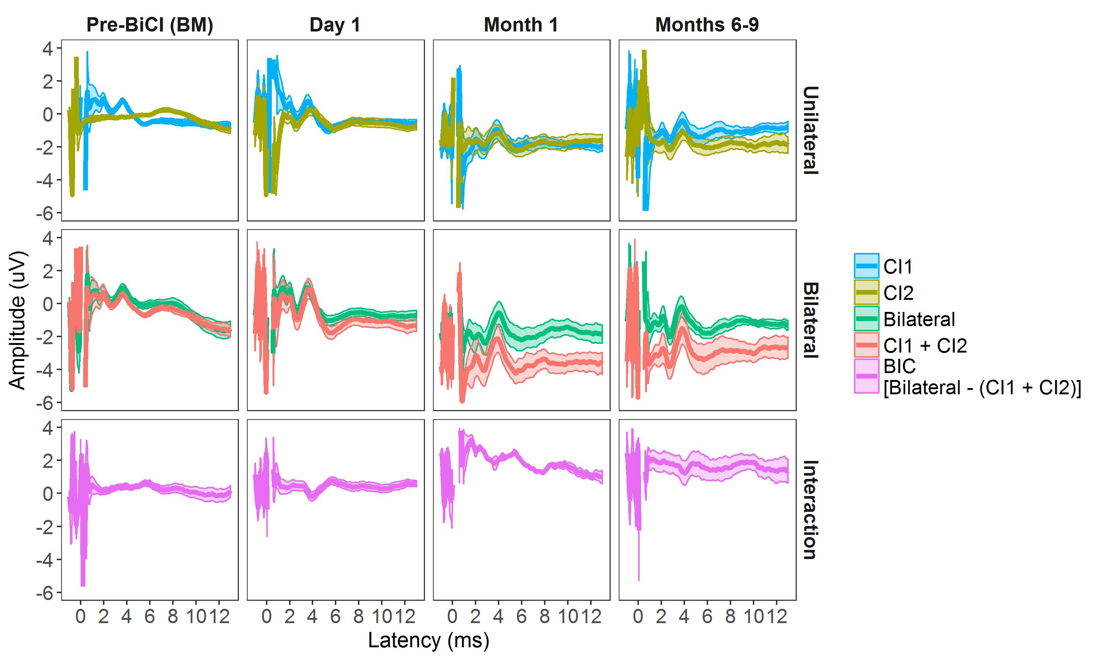
Design of Controllable Flexible Instruments to Facilitate Endoscopic Ear Surgery
Email:
arushri.swarup@mail.utoronto.ca
Arushri Swarup^{1,2}, Adrian L. James^{1,3}
¹Centre for Image Guided Innovation and Therapeutic Intervention, The Hospital for Sick Children, Toronto, ON, Canada
²Institute of Biomaterials and Biomedical Engineering, University of Toronto, Toronto, ON, Canada
³Department of Otolaryngology – Head and Neck Surgery, Faculty of Medicine, University of Toronto, Toronto, ON, Canada
Objective:
To evaluate whether a period of bimodal stimulation provides an advantage for bilateral brainstem development in bilateral CI users.
Results
Asymmetric speech perception with bimodal hearing favours the first implant but reduces with bilateral implant use
Background
Children require timely access to balanced bilateral input in each ear for symmetric brainstem development, binaural processing and development of binaural/spatial hearing¹. Prolonged unilateral stimulation in children who are bilaterally deaf abnormally strengthens pathways from the stimulated ear which impedes later efforts to restore binaural hearing with a second implant^{2,3}.
Combined acoustic-electric (bimodal) hearing may provide an advantage by stimulating pathways from both ears, thereby protecting the binaural system for later bilateral CI use. On the other hand, bimodal stimulation introduces significant (>1 ms) stimulus conduction delays which may impede binaural processing in the brainstem^{4,5}.
A
B
Figure 2. Speech perception in each ear
(A) Speech perception differed by ear and group (F(4,52)=6.6, p<0.01). Significantly asymmetric speech perception favoured CI1 (blue) in long sequential bilateral CI users (-33.7 ± 7.8 RAU, z=-4.3, p<0.01) and bimodal users (-33.9 ± 9.1 RAU, z=-3.7, p<0.01), which reduced within 0.9 ± 1.4 years with bilateral CIs for the bimodal sequential group (12.4 ± 9.1 RAU, z=-1.4, p=0.94).
Speech perception was more accurate for CI2/left ear (yellow) of simultaneous and short sequential bilateral CI users than that of long sequential bilateral CI users (z=3.7, 4.4 respectively, p<0.01) and the hearing aid of bimodal users (z=-3.6, -3.7 respectively, p<0.01). These differences are further highlighted by the asymmetries (green) shown in (B). Note: bimodal testing was completed 1.13 ± 1.12 years prior to bilateral implantation.
Hypotheses
Bilateral cochlear implants provide better access to high-frequencies than bimodal stimulation as measured by more symmetric speech perception.
Bimodal hearing stimulates bilateral auditory pathways thereby promoting bilateral symmetry and integration with bilateral CIs.
Initial rostral brainstem asymmetries tend to decrease with bilateral cochlear implant use
Methods
III
III
Participants
In this study, 19 bimodal users who received a second CI were followed over the first 3-6 months of bilateral CI used. Average pure tone hearing thresholds in their first and second implanted ears were 97.2 ± 11.3 and 88.6 ± 11.5 dB HL respectively. Measures were compared to previously studied groups of children who used bilateral CIs⁶. See Table 1 for demographic details.
Table 1. Demographic information for all bilateral CI users
V
V
Group | N | Gender Female:Male | Left:Right CI1 | Age at CI1 (years) | Age at CI2 (years) | Delay (years) | BiCI Use at Speech Perception Test (years)
Bimodal Sequential | 19 | 12:7 | 6:13 | 5.18 ± 3.82 | 10.14 ± 4.20 | 4.97 ± 3.91 | 0.89 ± 1.41
Long Sequential | 16 | 8:8 | 0:16 | 1.60 ± 0.56 | 5.86 ± 2.09 | 4.25 ± 1.74 | 0.86 ± 1.46
Short Sequential | 15 | 7:8 | 0:15 | 1.54 ± 0.75 | 2.39 ± 0.78 | 0.85 ± 0.11 | 1.45 ± 1.75
Simultaneous | 15 | 8:7 | 0:15 | 1.41 ± 0.60 | 1.41 ± 0.60 | 0.00 ± 0.00 | 1.99 ± 1.08
III-V
III-V
Measures
Conditions:
Unilateral
Bilateral
Figure 3. Peak ABR latencies at bimodal test and CI2 activation
Figure 4. Peak ABR latencies with bilateral CI use
CI1
HA/CI2
HA/CI2
CI1
An expected acoustic delay existed for all brainstem waves in the bimodal group (p<0.01). Among bilateral CI users at second CI activation, peak latencies were similar for eIII (all p>0.05), differed by group and ear for eV (F(3,43)=3.4, p=0.03), and longer CI2 (yellow) than CI1 (blue) for the III-V inter-wave interval (F(1,43)=5.8, p=0.02). eV latencies from CI1 were shorter for bimodal sequential and long sequential users, resulting in larger asymmetries (green) for these groups than for simultaneous bilateral CI users.
The latency asymmetries identified at CI2 activation tended to decrease with bilateral CI use for wave eV (Χ²(1)=3.2, p=0.07) but not for wave eIII (Χ²(1)=1.1, p=0.30) or the III-V inter-wave interval (Χ²(1)=2.7, p=0.10). This was assessed using linear mixed effects regression by adding a fixed effect of time to a null model containing a fixed effect of group (given the initial asymmetries, or intercepts, identified in Figure 3) and random intercept and slope effects of time per group and per participant.
Table 2. Measures collected for all bilateral CI users
Measure | Stimulus | Delivery
Speech Perception | Speech; age-appropriate tests | Speakers
EEG: Auditory Brainstem Response (ABR) (see Figure 1) CZ referenced to A1/A2 | 11 Hz: Acoustic clicks (non-implanted ears) Biphasic electric pulses (implanted ears) | Insert earphone Apical (#20) electrode (direct stimulation)
Binaural interaction is present
but prolonged at second implant activation
Binaural interaction latencies shorten with bilateral implant use for children who had limited unilateral deprivation
Figure 5. CI1 eV and BIC latencies upon CI2 activation
Figure 6. Latency difference (BIC re: CI1) with bilateral CI use
Presence of a BIC increased when brainstem responses were matched for timing and amplitude with bilateral CIs. The BIC latency (pink) was significantly delayed relative to the eV latency of CI1 (blue) for all sequential (p<0.01) but not simultaneous (p=0.99) bilateral CI users (2-way interaction: F(3,29)=3.8, p=0.02). The extent of latency prolongation (difference; purple) for the BIC did not differ by across groups (F(3,29)=1.2, p=0.31).
Differences between BIC and CI1 eV latencies changed with bilateral CI use in different ways for per group (Χ²(3)=10.9, p=0.01) as assessed by linear mixed effects regression (random intercept and slope per group; fixed effects of group and time). As identified in Figure 5, initial prolongations existed (intercepts) for all sequential users. Latency differences between BIC and CI1 eV tended to decrease with bilateral CI use in children who had limited unilateral deprivation (i.e., bimodal and short sequential users), although the relationship was not significant in each group alone (p=0.30, 0.25 respectively).
Discussion and Conclusions
No clear bimodal advantage in this cohort who had poor residual hearing. Pathways were stimulated with bimodal use but there were still brainstem asymmetries with bilateral CIs.
Brainstem and speech perception showed limitations of bimodal input with poor residual hearing.
Bilateral implantation improved access to bilateral input as shown by reduced asymmetries in speech perception and brainstem responses.
Delayed bilateral implantation may have allowed persistent asymmetries in brainstem development that favour the first implanted ear.
All children with bilateral Cis exhibited integration, as evidenced by the presence and latency of binaural difference measures.
→ For children who have poor residual hearing, quicker transition from bilateral hearing aids to bimodal to bilateral CI may be warranted to provide best access to bilateral hearing.
References
Gordon K, Henkin Y, Kral A (2015). Asymmetric Hearing During Development: The Aural Preference Syndrome and Treatment Options. Pediatrics 136:141–153.
Gordon KA, Wong DDE, Papsin BC (2013). Bilateral input protects the cortex from unilaterally-driven reorganization in children who are deaf. Brain J Neurol, 136:1609–1625.
Jiwani S, Papsin BC, Gordon KA (2016). Early unilateral cochlear implantation promotes mature cortical asymmetries in adolescents who are deaf. HBM, 37:135–152.
Polonenko MJ, Papsin BC, Gordon KA (2015). The effects of asymmetric hearing on bilateral brainstem function: findings in children with bimodal (electric and acoustic) hearing. Audiol Neurootol, 20 Suppl 1:13–20.
Zirn S, Arndt S, Aschendorff A, Wesarg T (2015). Interaural stimulation timing in single sided deaf cochlear implant users. Hear Res, 328:148–156.
Gordon KA, Valero J, van Hoesel R, Papsin B (2008). Abnormal timing delays in auditory brainstem responses evoked by bilateral cochlear implant use in children. Otol Neurootol, 29:193-198.
Figure 1. ABR responses and calculating binaural interaction
Mean ± SD auditory brainstem responses (ABR) were recorded at 4 time points (pre-CI2/Bimodal; post-CI2 day 1, month 1, months 3-9) to unilateral input delivered to CI1 (blue) and CI2/HA (yellow), and to bilateral input delivered simultaneously to both ears (‘Bilateral’, green). To calculate binaural interaction (pink), unilateral responses (blue and yellow) were added together (‘CI1 + CI2’, orange) and subtracted from the bilateral response (green). Binaural interaction components (BIC) were tiny and difficult to identify in individual recordings for bimodal users. Identification increased when inputs were matched for timing and amplitude in bilateral CI users.

